Slide 1
THE SIENCE BEHIND

Slide 2
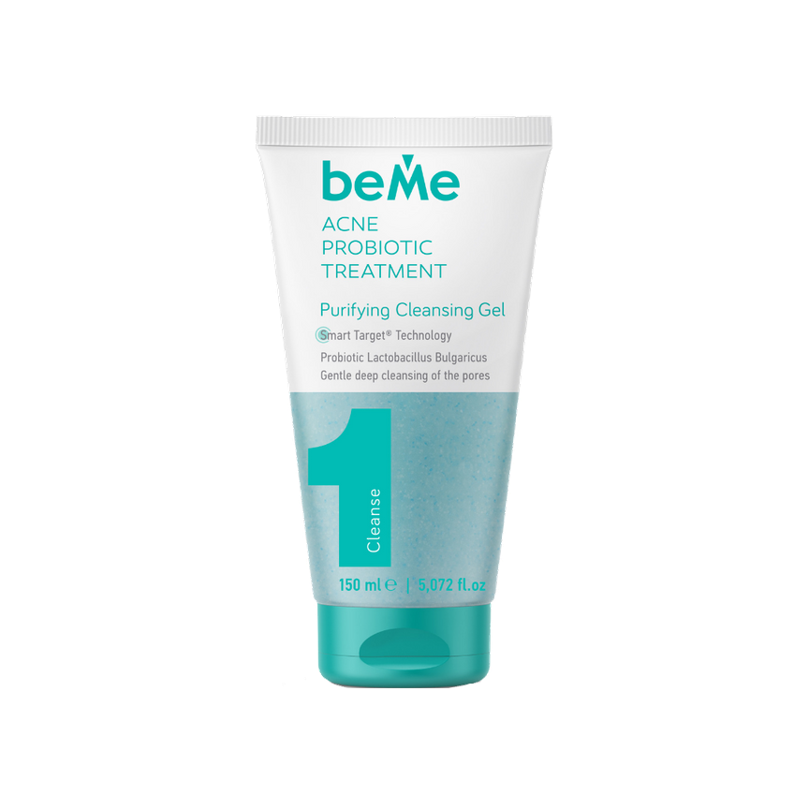
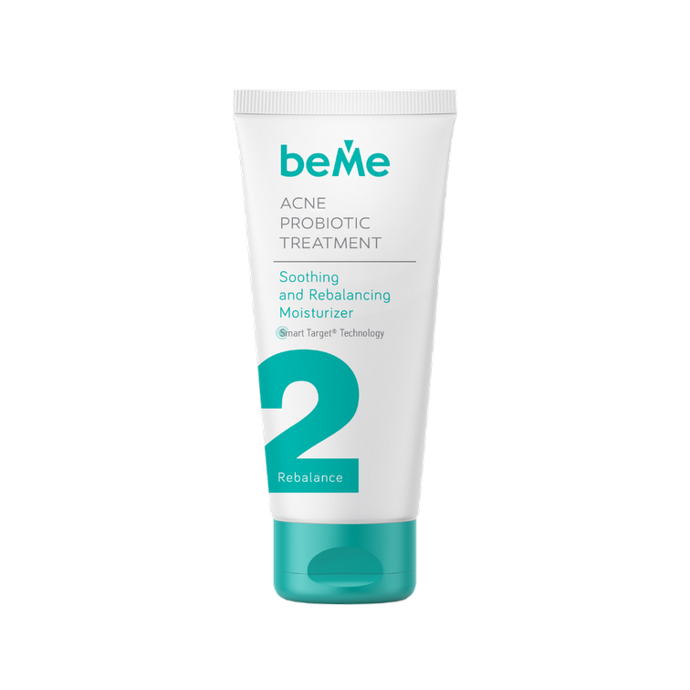
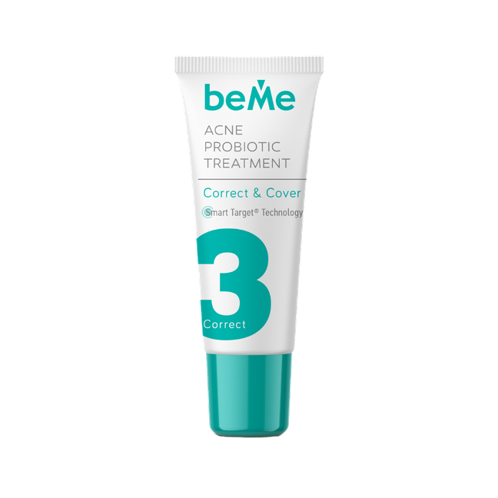
OUR PRODUCTS
HIGH TECHNOLOGICAL AND ETHICALY SOURCED
PURIFIENG CLEANSING GEL
Acne Probiuotic Treatment
REBALANCING AND MOISTURIZING CREAM
Acne Probiuotic Treatment
CORRECT&COVER
Acne Probiuotic Treatment

Slide 3
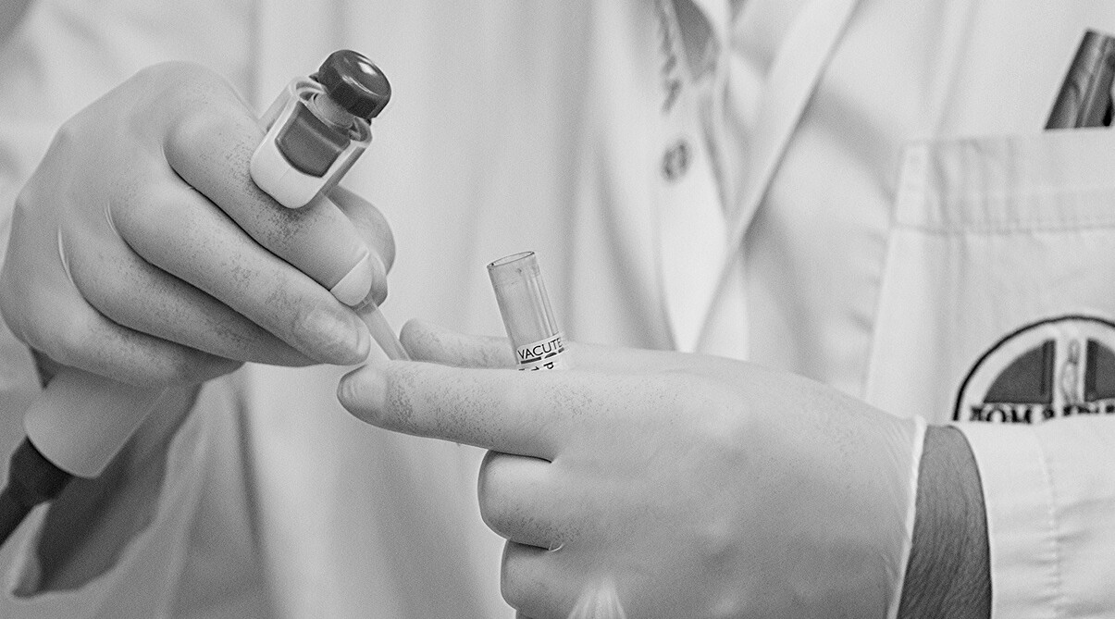
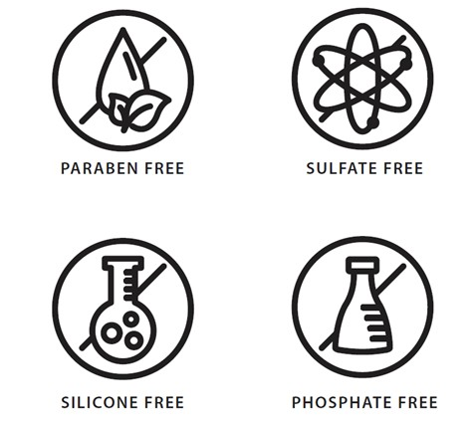
WHAT WE'VEDONE RIGHT
Our products are MADE WITH LOVE using the most effective, purest, ethically sourced, cruelty free ingredients
to heal Acne-Prone skin.
MADE WITHOUT a long list of questionable ingredients, including Parabens, Sulphates, Silicone, Sulfate, Phosphate to name only a few.
Our products are designed to the highest
level of performance, efficacy – and yet we have not compromised on YOUR
health.

Slide 4
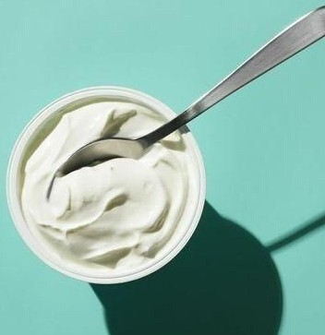

OUR UNIQUE ACNE FIGHTING INGREDIENT- PROBIOTIC LACTOBACILLUS BULGARICUS
ACB Yogurt Dermal Respiratory Factor PF
is produced by prompting live Lactobacillus bulgaricus cells to secrete synergistically active compounds, by striking the Lactobacillus cells with specific wavelengths of UV radiation. Through the use of biofermentation and various filtration techniques, such as tangential flow filtration, this secretion is then isolated and extracted from the live bacteria cell.
Yogurtene® Balance combines the skin benefits of Yogurt with the prebiotic activity of Inulin, a vegetable fructose polysaccharide derived from chicory.

Slide 5
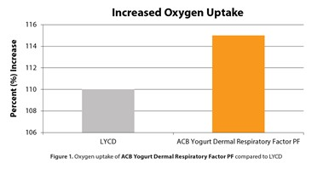

EFFICACY DATA
In vitro analysis was used to determine:
ACB Yogurt Dermal Respiratory Factor PF’s effect on increasing cellular oxygen uptake. Cultured human dermal fibroblasts maintained in culture flasks were prepared by replacing the culture media with PBS supplemented with magnesium, calcium, and succinate. The cells were incubated for 4 hours and then harvested and resuspended in PBS with magnesium and calcium. The 2.0 x 106 titers of cells were transferred to an oxygen electrode chamber where the basal oxygen consumption was measured by means of an oxygen electrode. (Hansatech DW3) Untreated cells were used to obtain a baseline oxygen consumption measurement. The cells were then cleared and recharged with a fresh titer of cells to which was added 0.25
% (w/w) of ACB Yogurt Dermal Respiratory Factor PF. Results are expressed relative to the number of viable cells recovered from the electrode chamber. Clearly, ACB Yogurt Dermal Respiratory Factor PF produced an increase in oxygen uptake comparable to yeast derived LYCD.

Slide 6
PURIFIENG CLEANSING GEL
ACTIVE INGREDIENTS
ACB Yogurt Dermal Respiratory Factor PF Is derived from the Lactobacillus used to make yogurt, and acts as a probiotic capable of stimulating collagen synthesis, increasing oxygen uptake and increasing intracellular ATP production
INCI
AQUA, COCO-GLUCOSIDE, LAURYL GLUCOSIDE, COCAMIDOPROPYL BETAINE, ACRYLATES COPOLYMER, POLYSORBATE 20, DIATOMACEOUS EARTH, PARFUM, PHENOXYETHANOL, ETHYLHEXYLGLYCERIN,
SODIUM HYDROXIDE, CELLULOSE ACETATE, CI74160, GLYCERINE, SODIUM LAURETH
SULPHATE, O-PHENYLPHENOL, LACTOBACILLUS BULGARICUS FERMENT FILTRATE, DISODIUM EDTA, SODIUM CHLORIDE, CITRIC ACID, HYDROXYCITRONELLAL, LINALOOL, CITRONELLOL,
HEXYL CINNAMAL, LIMONENE, ALPHA-ISOMETHYL IONONE
Micro Algue 80/DIATOMACEOUS EARTH - Is a mineral of biogenic origin. Micro Algue 80 is a product derived from the algae
Diatom. This natural soft exfoliant is respectful to the environment and its porous nature also allows for the ability to absorb oil.
Luffa Blue Exfoliator 30/ CELLULOSE ACETATE- Luffa Cylindrica Fruit. Luffa 30 by Lessonia acts as an exfoliating agent. It is based on soft plant fibers which are very homogeneous in size. It allows an accurate and soft exfoliation.

Slide 7
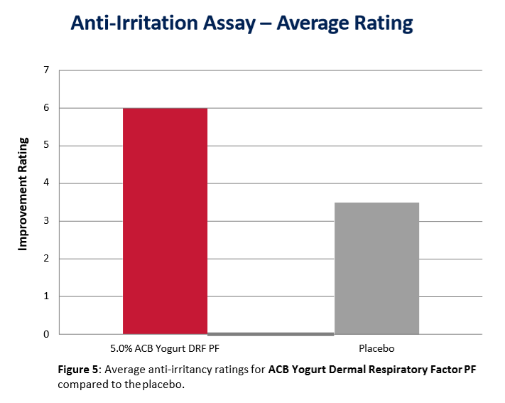
ACB YOGURT DERMAL TEST

Slide 8
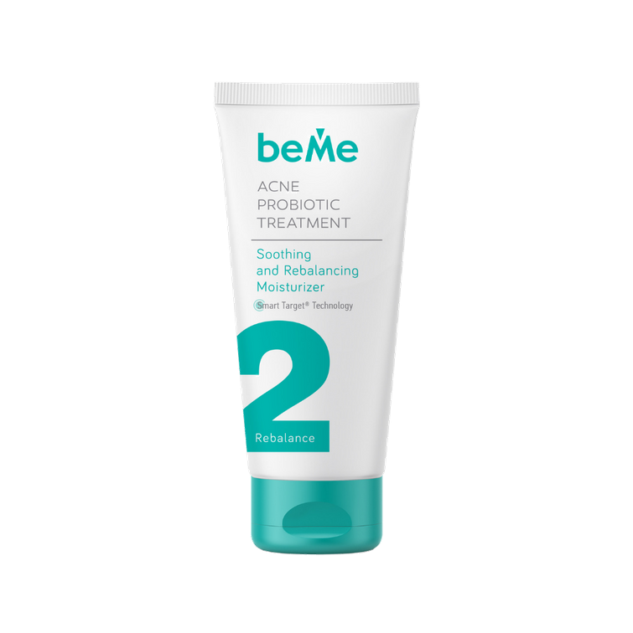
REBALANCING AND MOISTURIZING CREAM
ACTIVE INGREDIENTS
Encapsulated Salysic Acid (GS-SA2BS Glycospheres) This active ingredient is encapsulated and trough the
Smart Target Technology is delivered to the skin over a period of time and has controlled release. It is used to enhance exfoliation of the surface.
Lactobacillus Bulgaricus Ferment Filtrate
Math Marine- MATMARINE™ blue ingredient, obtained through biotechnology from a marine
Pseudoalteromonas strain, is ideal for oily and combination skin. It is the perfect biotechnological ingredient to reduce extra shininess, pores, spots, and sebum.
INCI
AQUA, ROSA DAMASCENA FLOWER WATER, C9- 12 ALKANE, CAPRYLYL CAPRYLATE/CAPRATE, LACTOBACILLUS BULGARICUS FERMENT FILTRATE, ARACHIDYL ALCOHOL, BEHENYL ALCOHOL, ARACHIDYL GLUCOSIDE, GLYCERYL STEARATE CITRATE, PENTYLENE GLYCOL, 4-T- BUTYLCYCLOHEXANOL, PSEUDOALTEROMONAS FERMENT EXTRACT, INULIN, YOGURT POWDER, BUTYLENE GLYCOL, PENTYLENE GLYCOL, SALICYLIC ACID, PALMITOYL HYDROXYPROPYLTRIMONIUM AMYLOPECTIN / GLYCERIN CROSSPOLYMER, 1,2-HEXANEDIOL, CAPRYLYL GLYCOL, HYDROGENATED LECITHIN, PHYTOSPHINGOSINE, PHYTOSPHINGOSINE HCL, PARFUM, PHENOXYETHANOL, ETHYLHEXYLGLYCERIN, POLYACRYLATE CROSSPOLYMER-6, DISODIUM EDTA, GLYCERIN, CITRIC ACID , HYDROXYCITRONELLAL, LINALOOL, CITRONELLOL, HEXYL CINNAMAL, LIMONENE, ALPHA-ISOMETHYL IONONE

Slide 9
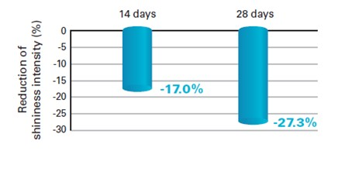
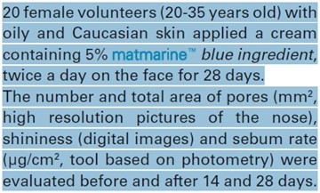
MATH MARINE TEST

Slide 10
REBALANCING AND MOISTURIZING CREAM
INCI
AQUA, ROSA DAMASCENA FLOWER WATER, C9- 12 ALKANE, CAPRYLYL CAPRYLATE/CAPRATE, LACTOBACILLUS BULGARICUS FERMENT FILTRATE, ARACHIDYL ALCOHOL, BEHENYL ALCOHOL, ARACHIDYL GLUCOSIDE, GLYCERYL STEARATE CITRATE, PENTYLENE GLYCOL, 4-T- BUTYLCYCLOHEXANOL, PSEUDOALTEROMONAS FERMENT EXTRACT, INULIN, YOGURT POWDER, BUTYLENE GLYCOL, PENTYLENE GLYCOL, SALICYLIC ACID, PALMITOYL HYDROXYPROPYLTRIMONIUM AMYLOPECTIN / GLYCERIN CROSSPOLYMER, 1,2-HEXANEDIOL, CAPRYLYL GLYCOL, HYDROGENATED LECITHIN, PHYTOSPHINGOSINE, PHYTOSPHINGOSINE HCL, PARFUM, PHENOXYETHANOL, ETHYLHEXYLGLYCERIN, POLYACRYLATE
CROSSPOLYMER-6, DISODIUM EDTA, GLYCERIN, CITRIC ACID , HYDROXYCITRONELLAL, LINALOOL, CITRONELLOL, HEXYL CINNAMAL, LIMONENE, ALPHA-ISOMETHYL IONONE
ACTIVE INGREDIENTS
Sim Sytive 1609- SymSitive® 1609 significantly alleviates stinging and burning by alleviating stinging up to 78% after 3 minutes and burning up to 80% after 3 minutes.
Phytosphingosine - Phytosphingosine is a natural, skin-identical active ingredient for personal care products. It is naturally present in the skin and effectively reduces the signs of acne, inhibits the growth of micro-organisms on the skin, reduces redness and inflamed skin. Replenish moisture content
Yogurtene_Balance- Yogurtene® Balance reduces the growth of pathogenic bacteria in favour of friendly microorganisms naturally present on the epidermis.

Slide 11
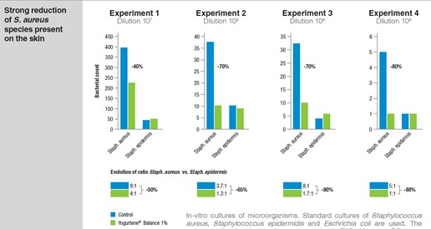
YOGURTHENE BALANCE TEST

Slide 12
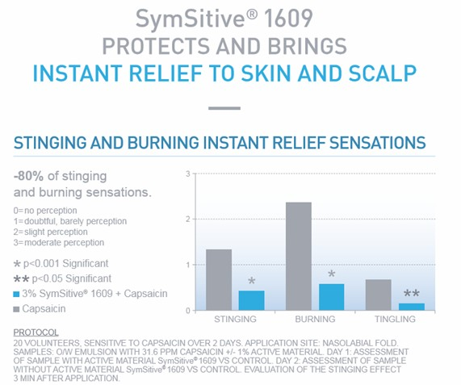
SYMSITIVE TEST

Slide 13
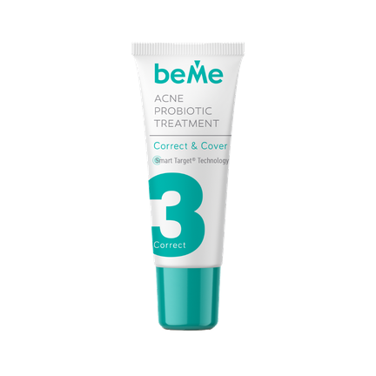
CORRECT & COVER
INCI
AQUA, DISTARCH PHOSPHATE, C9-12 ALKANE, GLYCERIN, ARACHIDYL ALCOHOL, BEHENYL ALCOHOL, ARACHIDYL GLUCOSIDE, HYDROGENATED LECITHIN, CAPRYLYL CAPRYLATE/CAPRATE, POLYGLYCERYL-6 STEARATE, POLYGLYCERYL-6 BEHENATE, INULIN, YOGURT POWDER, LACTOBACILLUS BULGARICUS FERMENT FILTRATE, MALTODEXTRIN, CALCIUM PANTOTHENATE, XANTHAN GUM, UREA, CAPRYLUL GLYCOL, PROLINE, ALANINE, SERINE, MAGNESIUM LACTATE POTASSIUM LACTATE, MAGNESIUM CHLORIDE, SODIUM CITRATE, PAPAIN, ETHYLHEXYLGLYCERIN, BUTYLENE GLYCOL, PENTYLENE GLYCOL, SALICYLIC ACID, PALMITOYL HYDROXYPROPYLTRIMONIUM AMYLOPECTIN / GLYCERIN CROSSPOLYMER, 1,2-HEXANEDIOL, CAPRYLYL GLYCOL, HYDROGENATED LECITHIN, PHYTOSPHINGOSINE, PHYTOSPHINGOSINE HCL, PARFUM, PHENOXYETHANOL, ETHYLHEXYLGLYCERIN, POLYACRYLATE CROSSPOLYMER- 6, DISODIUM EDTA, GLYCERIN, CITRIC ACID , CI 77891, CI
77492, CI 77491, CI 77499, CITRIC ACID, PENTYLENGLYKOL, (UND) 4-T-BUTYLCYCLOHEXANOL, HYDROXYCITRONELLAL, LINALOOL, CITRONELLOL, HEXYL CINNAMAL, LIMONENE, ALPHA-ISOMETHYL IONONE
ACTIVE INGREDIENTS
Encapsulated Salysic Acid (GS-SA2BS Glycospheres
Lactobacillus Bulgaricus Ferment Filtrate supports the healing process
Peelmoist- PEELMOIST™ molecular film is
designed to obtain an optimized delivery of papain and to provide an improved moisturization to the skin, helping to preserve the natural barrier function of the epidermis due to the ingredients contained from the natural
moisturizing factor.
Yogurtene Balance

Slide 14
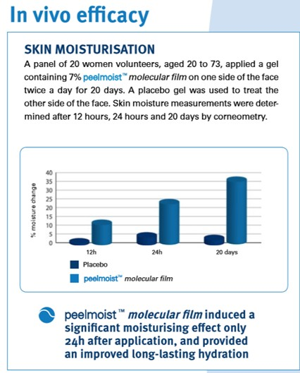
PEELMOIST TEST

Slide 15
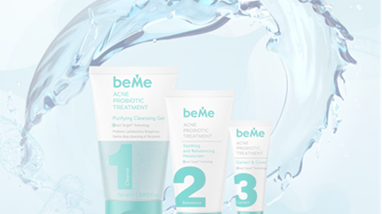


POTENTIAL IMPACT
“Over a thousand species of bacteria live on the surface of our skin,” Dr. Lener says. The skin microbiome, as it’s known, is a good thing. “Probiotivs are essential to fight infection, protect against environmental damage, regulate pH levels and keep the skin hydrated and healthy. I have recomended beMe for a daily anti-acne routine to a lot of may patience and it works”

Slide 16
TALK TO US!
EMAIL
office@beme-acne.com
PHONE
+359 2 989 18 00
OFFICE ADDRESS
Sofia, str. Parensov 37B; office 2

